Slide 1
Sharing Knowledge, Transforming Higher Ed
AMICAL Al Akhawayn University Ifrane, Morocco May 25th, 2023
Cathy N. Davidson
Senior Advisor to the Chancellor on Transformation
Distinguished Professor and Founding Director,
The Futures Initiative
The Graduate Center, CUNY
R. F. DeVarney Prof. Emerita of Interdisciplinary Studies
Duke University
Notes:
In this interactive talk [NB: INTERACTIVE SLIDES HAVE A RED HEADER], noted scholar of technology and higher education Cathy N. Davidson addresses the legacy institutions we’ve inherited from the Industrial Age and the radically different conditions facing students, higher education, and society today, She proposes an array of transformations any of us can enact in our classrooms, in our colleges and universities, and (perhaps most profoundly) in the ways we think about our own role in higher education and society at large.
This talk is drawn from Davidson’s “How We Know” trilogy of books (2011-2022) and her work with the Futures Initiative and HASTAC.org (called by NSF “the world’s first and oldest academic social network”).

Slide 2
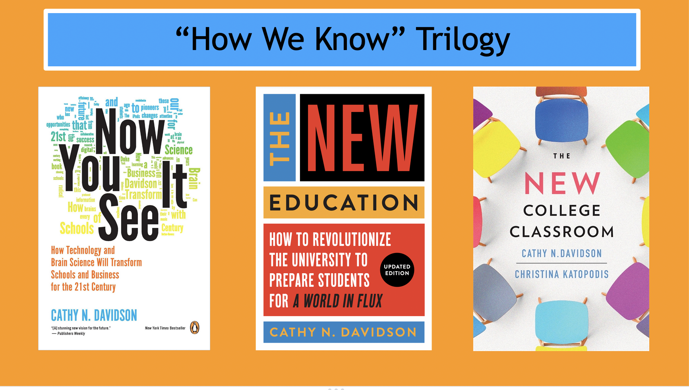

Slide 3
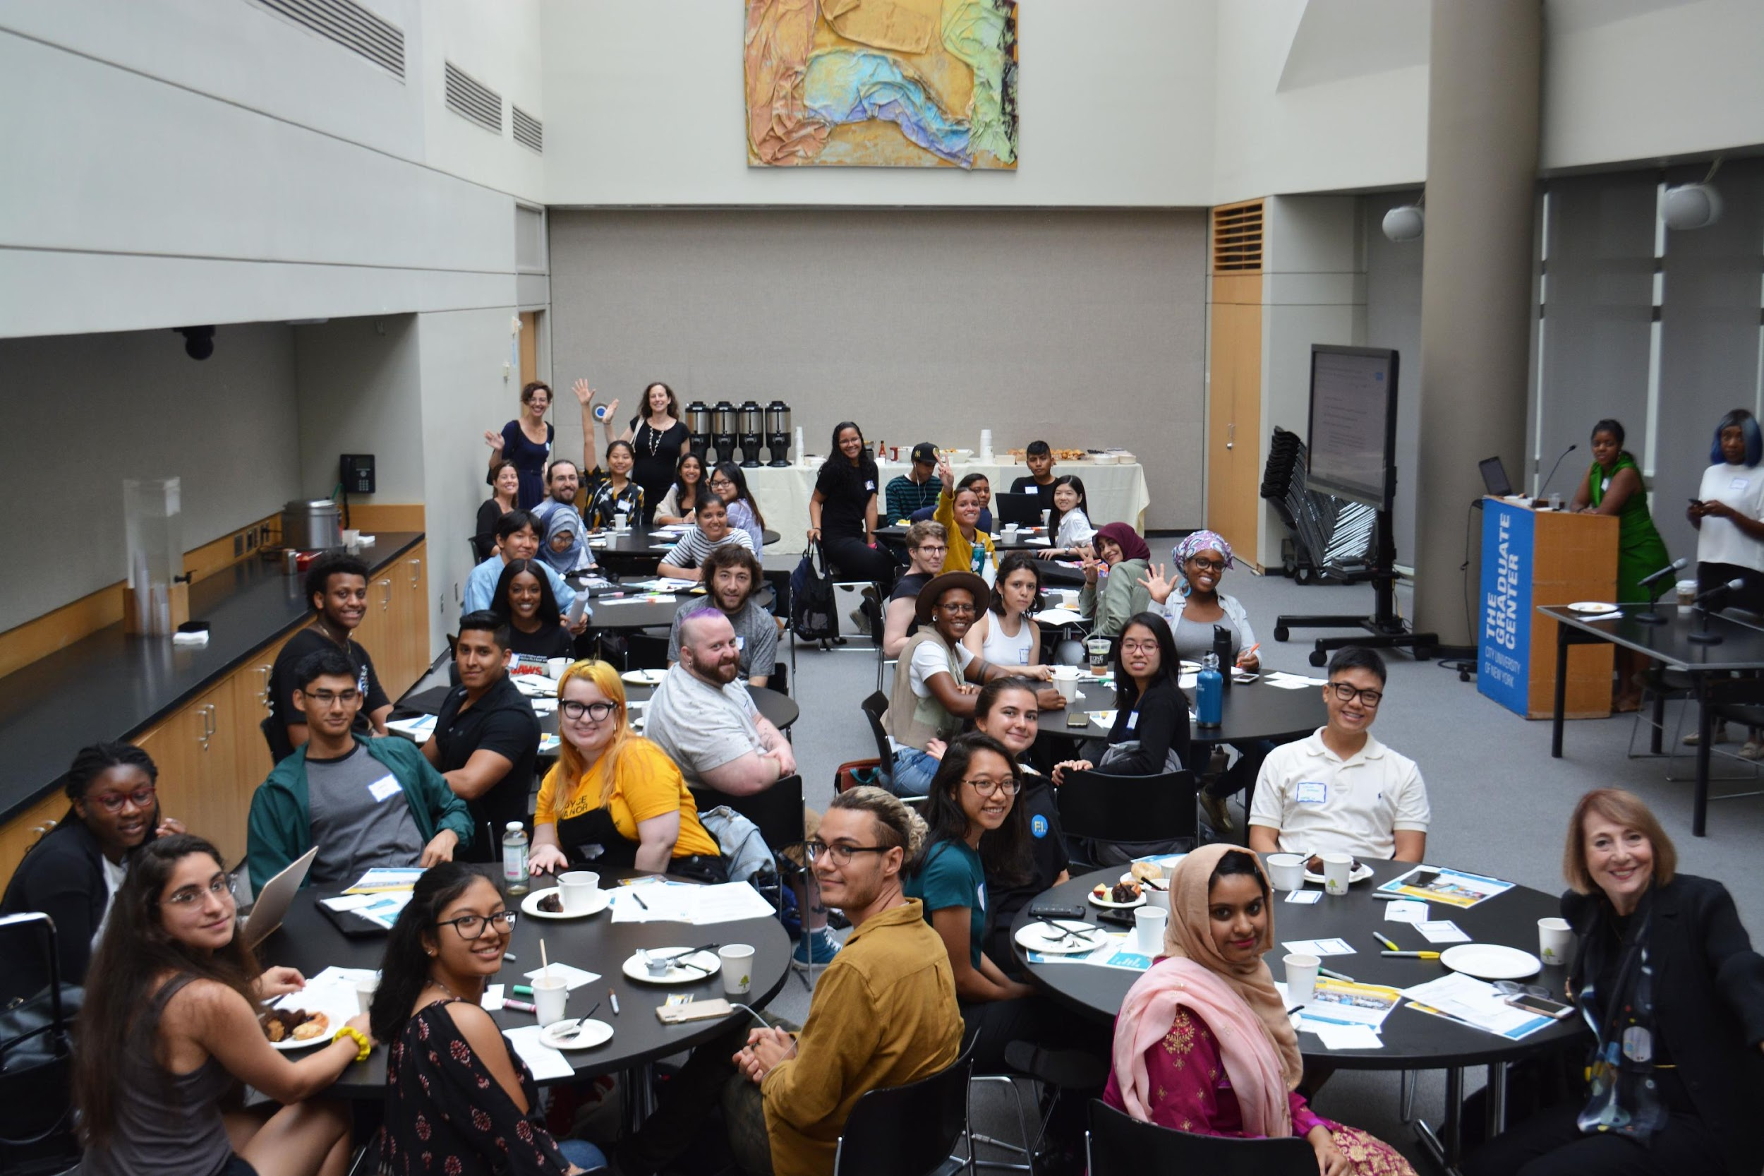
This talk is dedicated to our students. Thank you for inspiring us to work for a better future.

Slide 4
To be truly visionary we have to root our imagination in our concrete reality while simultaneously imagining possibilities beyond that reality.
“
”
—bell hooks

Slide 5
Think Pair Share
If you could wave a magic wand and change one thing about your college or university today, what would you change first?
[NB: “all the funding in the world” is taken for granted; what else??. . . ]
Notes:
INTERACTIVE: “Think and pair” with notecards. Share synthesized idea on Mentimeter

Slide 6
Part One:
Our Legacy

Slide 7
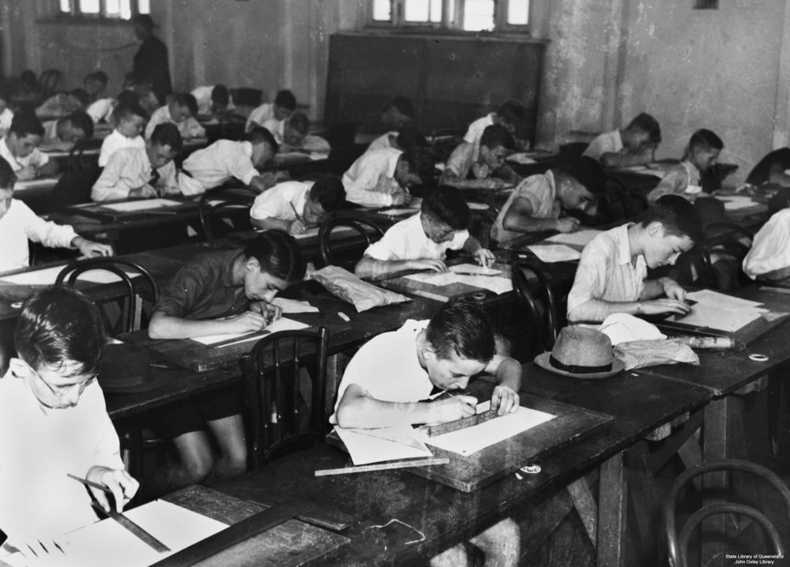
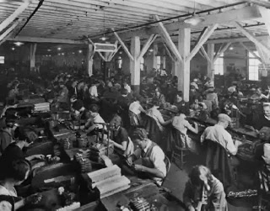
School, verb. From Farmers to Factory Workers

Slide 8
Industrial-Education Complex (1860-1925)
From Shopkeepers to Professional-Managerial Class
Scientific Labor Management
statistics, bell curve, eugenics, standard deviation, assembly line, punch clocks, mass production, standardization, production and efficiency quotas, quality control, specialized division of labor, scientific study of productivity outcomes from hourly “wage labor”(Marx)
Scientific Learning Management
mandatory public secondary schooling, K-12 curriculum requirements, research universities, public universities, Land Grant universities, Historically Black Colleges and Universities, junior colleges, majors, minors, electives, divisions, certification, graduate school, collegiate law school, nursing school, graduate school of education, collegiate business school, mandated contact hours, degree requirements, (Carnegie) credit hours, grades, IQ tests, giftedness, learning disabilities, multiple choice tests, college entrance exams, SATs, tenure, sabbaticals, faculty pensions, peer review, school rankings, donor-named chairs, corporate-sponsorship of research, adolescence, crits and thesis defenses, F (failure)...

Slide 9
Professionalizing the Industrial-Education Complex
American Chemical Society (1876). American Library Association (1876). Modern Language Association (1883). American Historical Association (1884). The New England Association of Schools and Colleges (1885). American Mathematical Society (1888). The Committee of Ten (1892). American Psychological Association (1892). The College Entrance Examination Board (1899). American Philosophical Association (1900). The Association of American Universities (1900). American Anthropological Association (1902). American Sociological Association (1905). American Association of University Professors (1915) . . .

Slide 10
Part Two:
Now

Slide 11
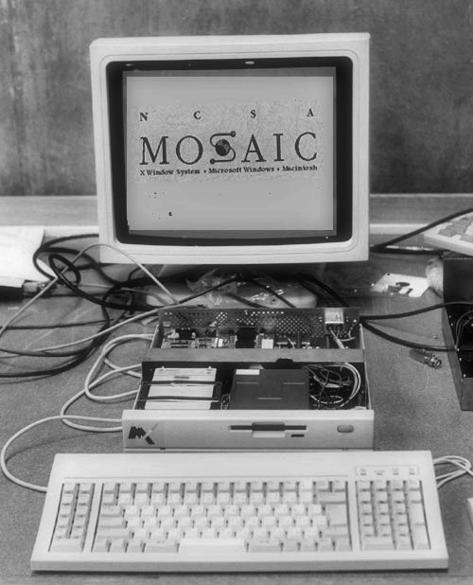
April 22, 1993
Anyone with an internet connection can communicate anything at all to anyone else with an internet connection …
• Without a pause or delete button
• Without identity or verification
• Without an editor or expertise
• Without data security or privacy
How do we prepare students for this world?

Slide 12
“Sequestered Problem Solving”
(Really? Is this the best we can do? In 2023?)
How do we prepare students for this world?

Slide 13
November 30, 2022: ChatGPT (1 million+ subscribers in 5 days)

Slide 14
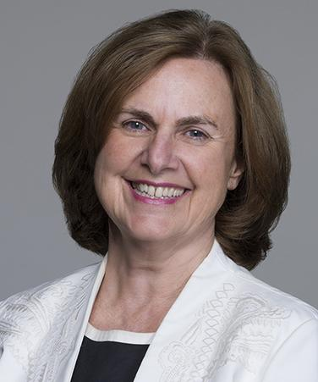
“The Top 100%”
18 Million Undergraduates
40%+ Community College
40% Work > 30 hours a week
25% Full time school & work
25% Over 25 years old
30% First gen college students
24% Low income
25% Food and housing insecurity
58% Female
45% Students of color
0.4% at Ivies
Dr. Gail Mellow, President Emerita LaGuardia Community College
Gail Mellow, “The Biggest Misconception About Students Today,” NYT, August 28, 2017

Slide 15
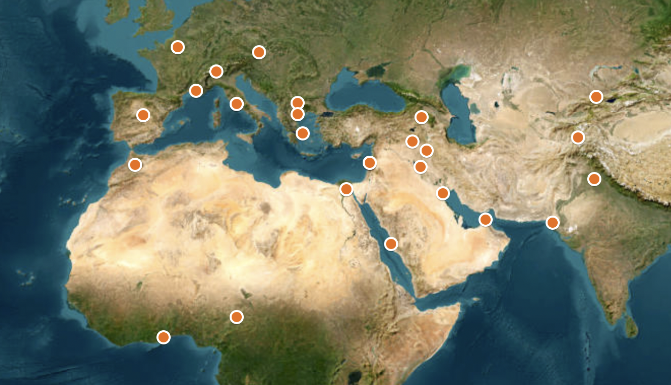
AMICAL Network: Global Diversities
Notes:
We have an untenable bifurcation of “liberal arts” versus “vocational education.”

Slide 16
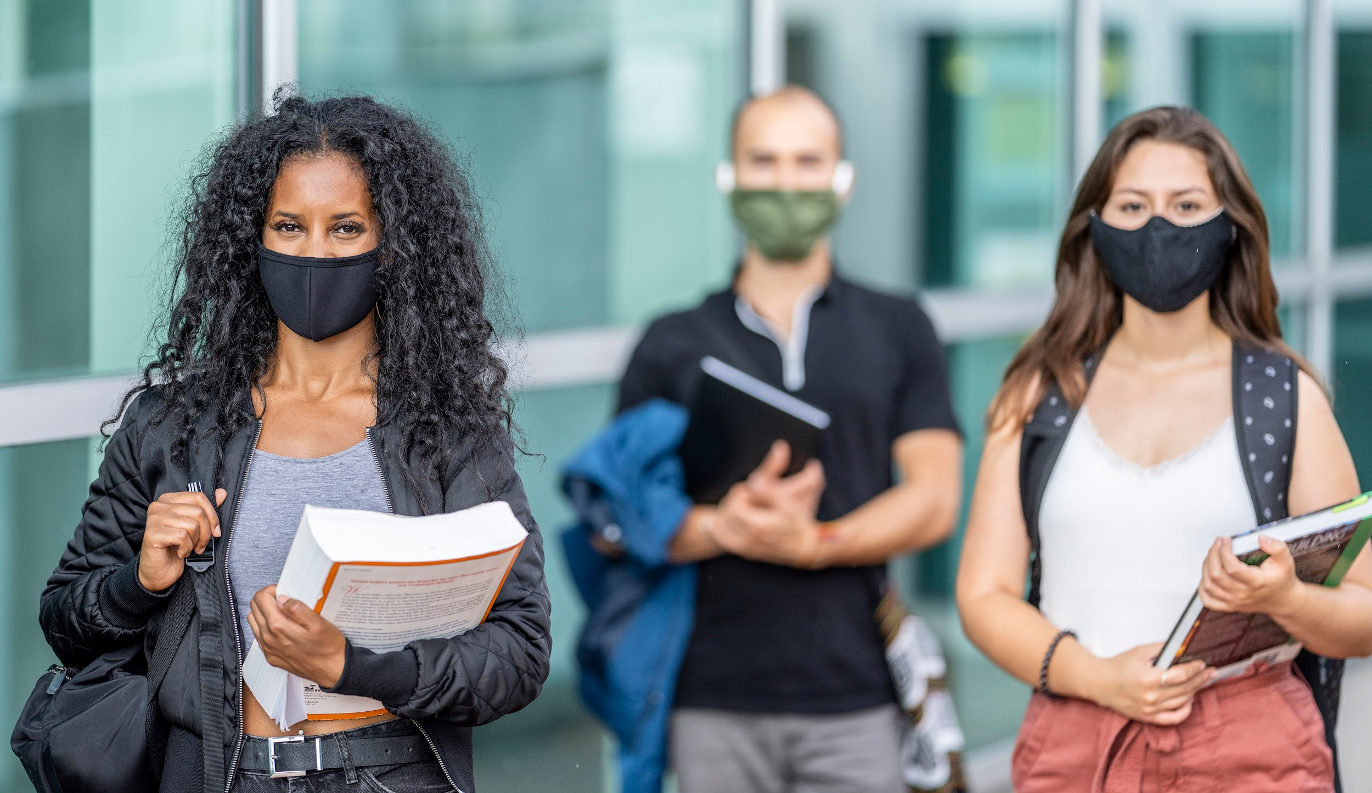
Disrupted education in over 150 countries
Affected 1.6 billion students worldwide
87% of US college students went online during Covid
The pandemic is far from over
Our 2023 world is not 2019

Slide 17
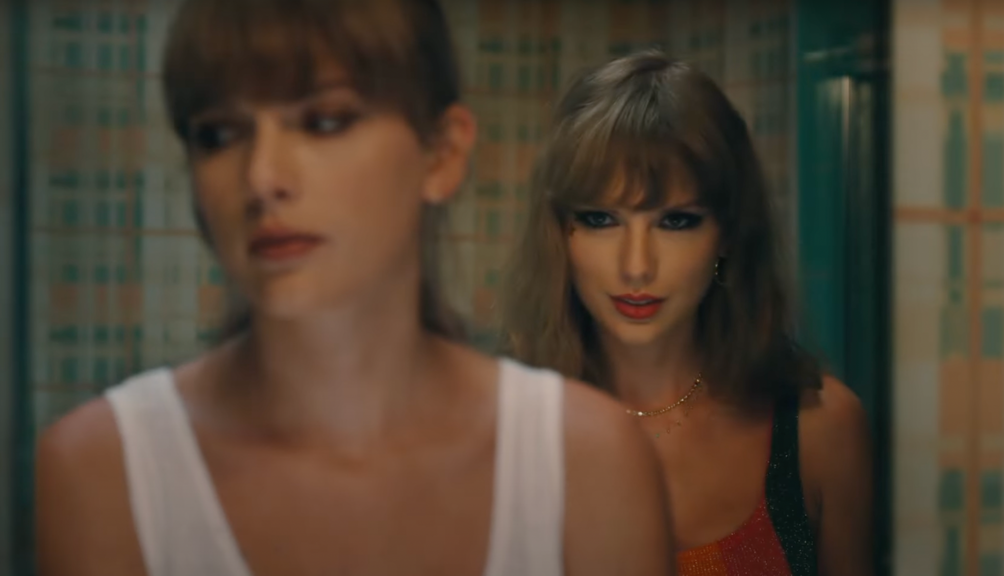
No one, in Jan 2020, would have predicted all of higher ed could go on line in a matter of days because of the pandemic crisis. We need to remember our own ability (and responsibility) to react, change, transform. (To quote the great 21st century poet Taylor Swift, “It’s me. I’m the problem. It’s me.”)

Slide 18
What legacy feature of your institution seems most anachronistic/irrelevant in 2023?
Notes:
INTERACTIVE: Word cloud Q on mentimeter (3-4 words) everyone is on mentimeter ….

Slide 19
Part Three:
Seven Ways to Transform Higher Ed
Notes:
\

Slide 20
We cannot change structural inequality with good will.
We must design new structures with equality at the core.

Slide 21
#1: Change the Reward Structure of Higher Ed
Research
Teaching
Service
Research
Teaching
Institutional
Leadership
Public
Impact

Slide 22
#2: Connect Admissions, Academic, and Career Services
University of Houston https://www.uh.edu/technology/advising/career-services/
Notes:
We have an untenable bifurcation of “liberal arts” versus “vocational education.”

Slide 23
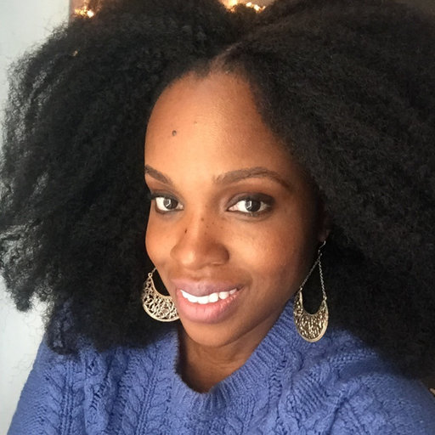
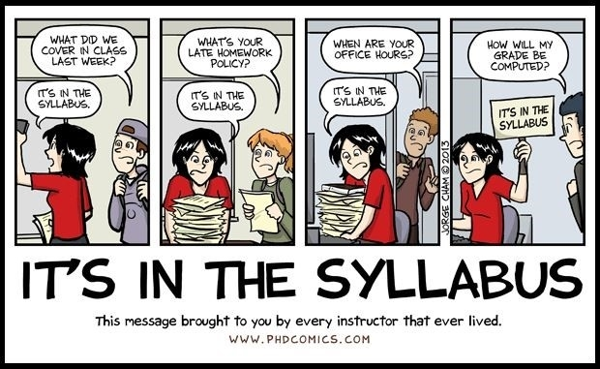
#3. Redesign Your Syllabus for “World Readiness”
Use pedagogies of care: make our widest goals, our mission statement, our care statements part of our syllabi
Make the link to Career Services part of our care for our students
Connect course content to crucial life, research, and career skills--including essential ways of using, analyzing, and evaluating information
https://www.hastac.org/blogs/adashima-oyo/2020/01/29/last-page
Adashima Oyo, Executive Director of the Futures Initiative, “The Last Page,” HASTAC.org
Notes:
Fix formatting

Slide 24
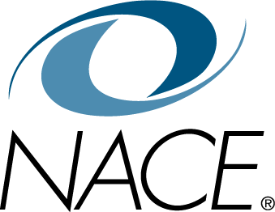
Learning Outcomes Are Career Outcomes: NACE (National Association of Colleges and Employers)
Career and self-development (knowing one’s own goals and strengths)
Communication skills
Critical thinking and problem solving
Equity, inclusion, anti-racist, and cross-cultural skills
Leadership
Professionalism
Teamwork
Technology basics [Psssst . . . we’ve got this!]
Resources:
https://studentaffairs.baruch.cuny.edu/wp-content/uploads/sites/6/2020/04/Resume-and-Cover-Letter-Guide.pdf
https://cla.umn.edu/career-readiness
Notes:
We have an untenable bifurcation of “liberal arts” versus “vocational education.” Lifelong learning: refers to the concept of learning throughout one's entire life.
·
Life-wide learning: refers to the concept of learning that takes place across all areas of an individual's life, including work, personal interests, and
community involvement. Life-deep learning: refers to the concept of learning that involves deep engagement with aparticular subject or area of interest. Continuous learning throughout one's entire life, in both formal and informal settings.--Paul Belanger, “Self Construction and Social Transformation,” UNESCO, 2015 https://repositorio.minedu.gob.pe/bitstream/handle/20.500.12799/4406/Self-construction%20and%20Social%20Transformation%20Lifelong,%20Lifewide%20and%20Life-Deep%20Learning.pdf?sequence=1 UNESCO Institute for Lifelong Learning And earlier Citation: Sacco K, Falk JH, Bell J (2014) Informal Science Education: Lifelong, Life-Wide, Life-Deep. PLoS Biol 12(11): e1001986.

Slide 25
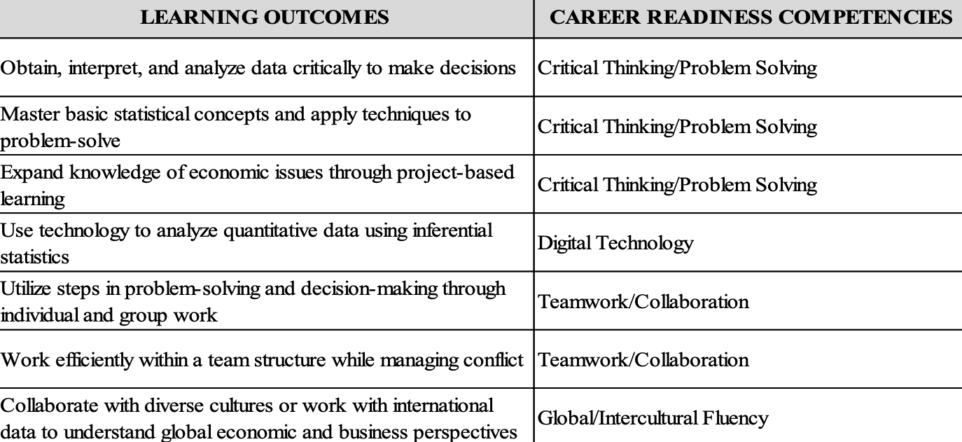
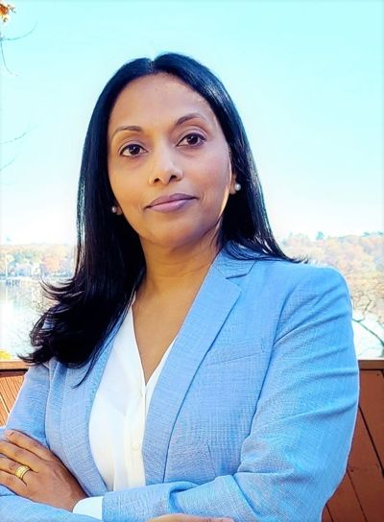
Schiro Withanachchi, Queens College (Econ 249, Applied Statistics & NACE Career Competencies)

Slide 26
Knowledge Is Power …
1st day assignment: Instead of the tedious and rarely effective “let’s go over the syllabus,” have students work in pairs/groups, review the syllabus, and connect the “basics” of the course to the career/“world readiness” competencies. Have them think big picture—“meta” and “mission.” 1. Career and self-development; 2. Communication skills; 3. Critical thinking and problem solving; 4. Equity, inclusion, anti-racist, and cross-cultural skills; 5. Leadership; 6. Professionalism; 7. Teamwork; 8. Technology basics.
Course Requirements or Learning Outcomes | Career Readiness Competencies
Notes:
“TAKE-HOME” INTERACTIVE … fill in the blanks later!

Slide 27
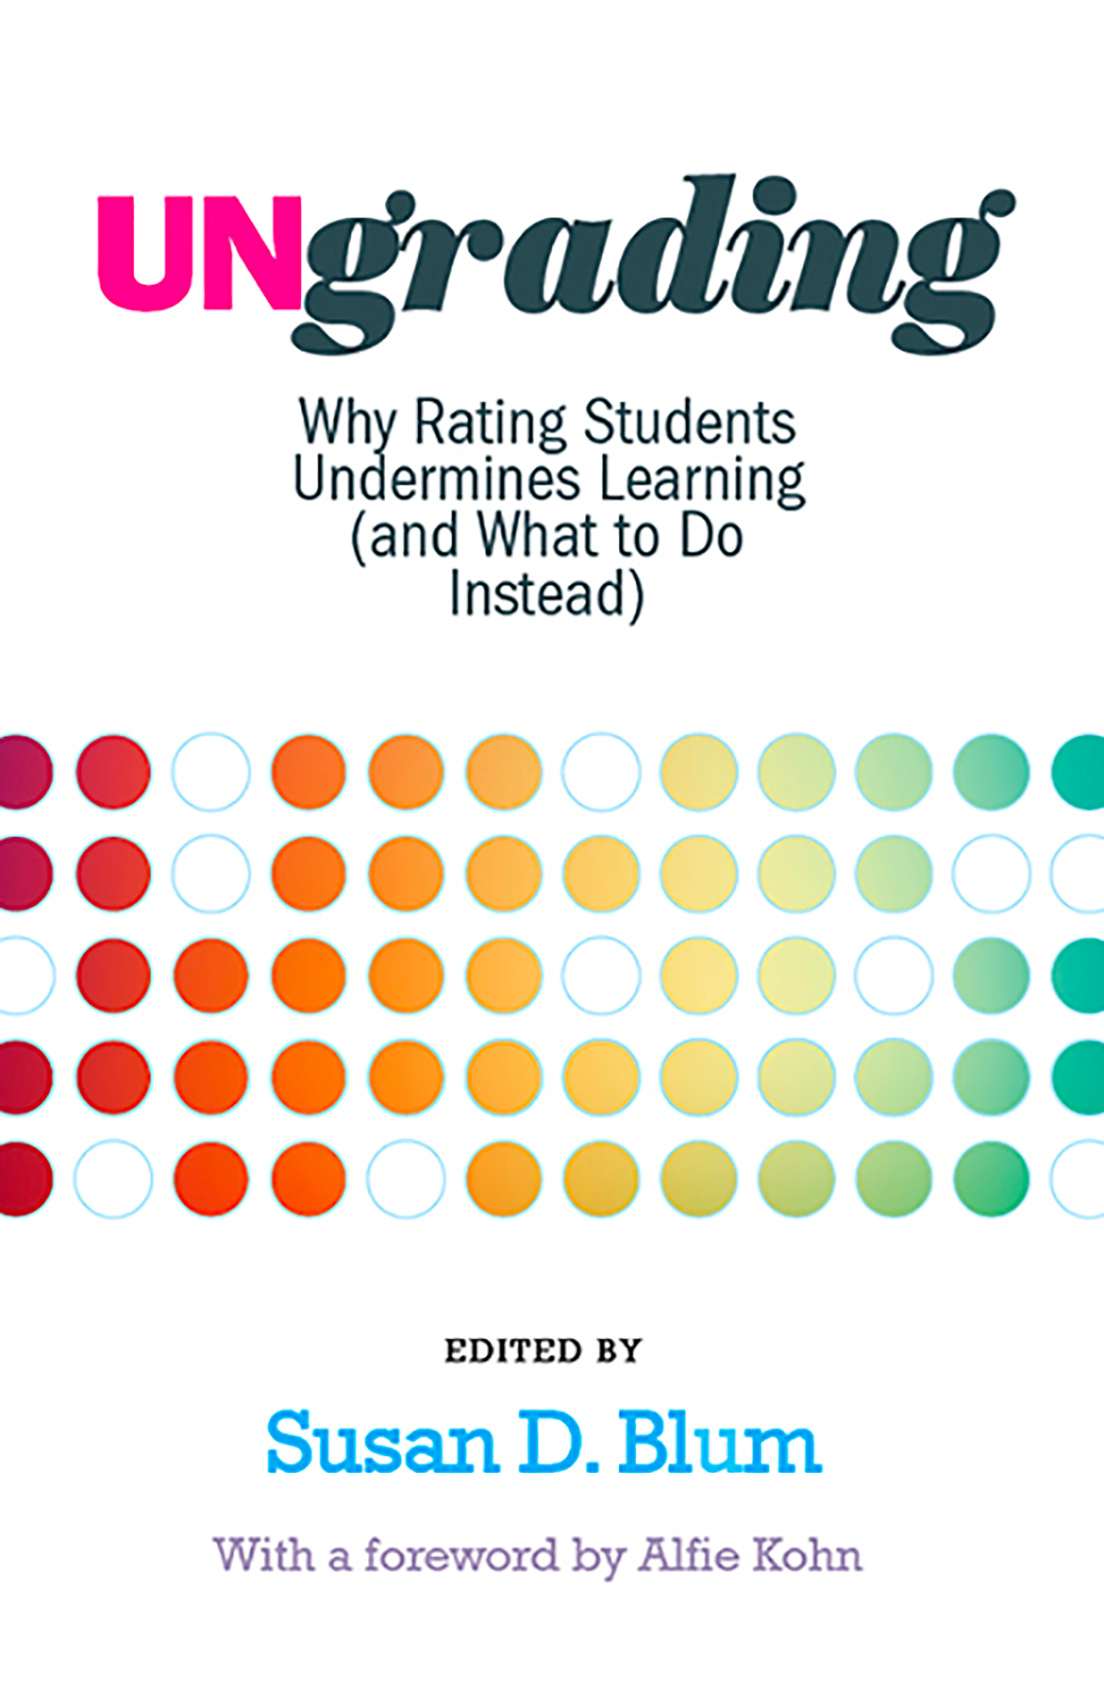
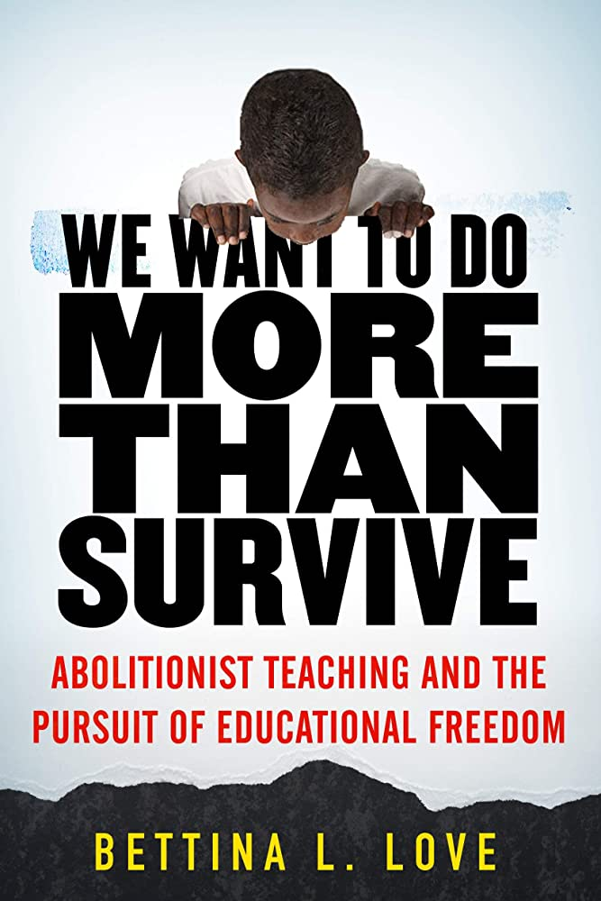
#4. Consider “Ungrading” and an “Open” Syllabus

Slide 28
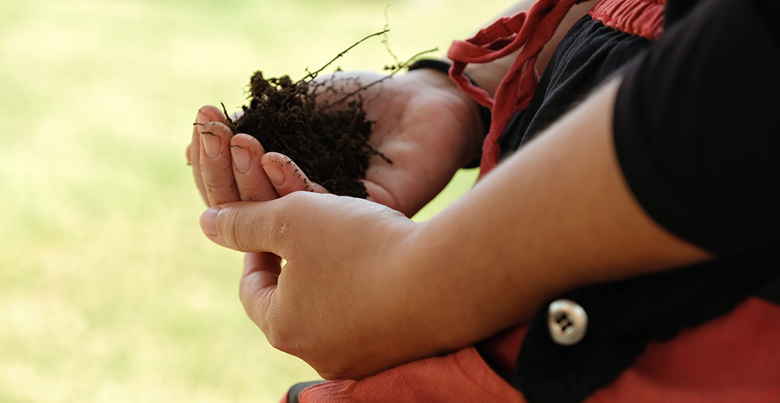
#5. Redesign General Education that Matters
Bass Connections, Duke University, “Soil and Spirit” Integrated Gen Ed Course
Futures Initiative

Slide 29
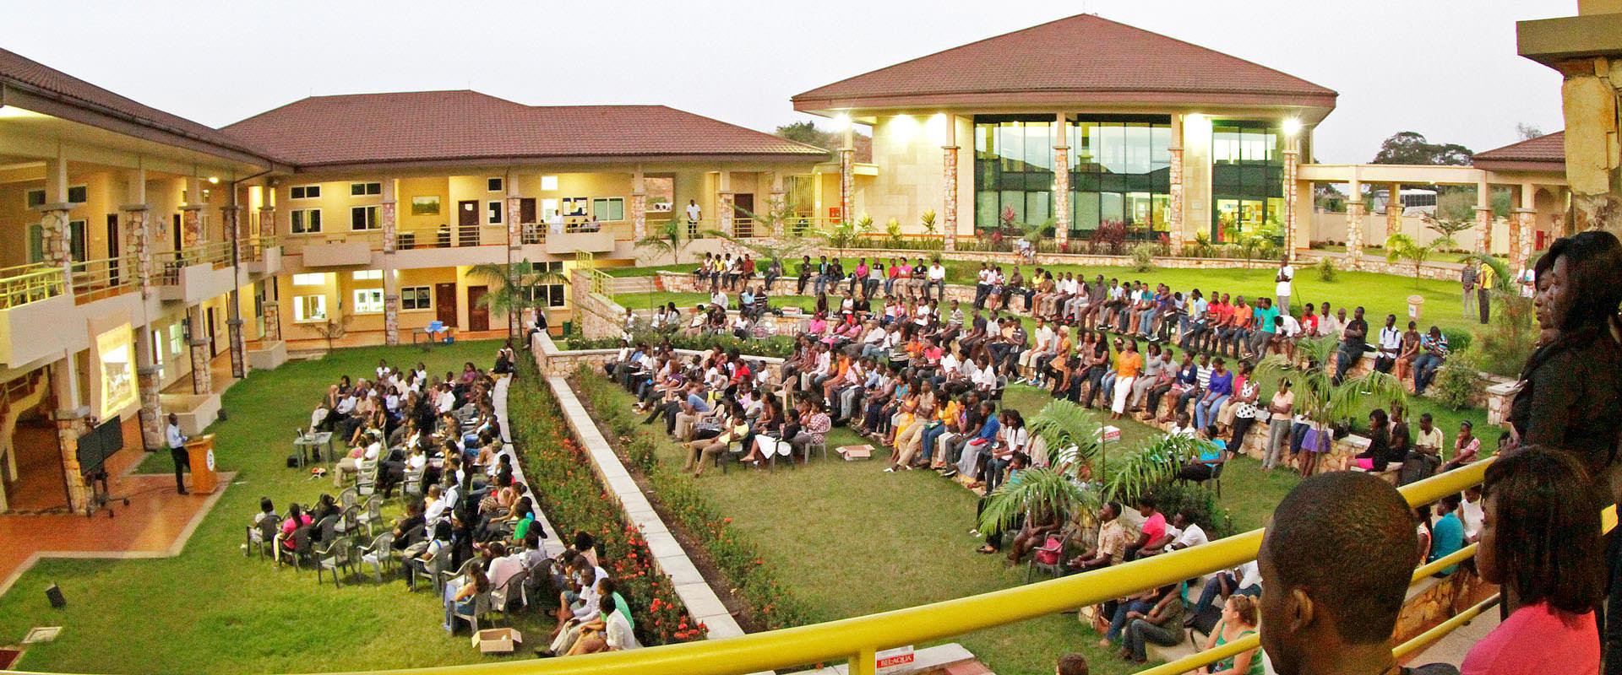
#6. Radically Remix and Update Our Majors and Minors with a MISSION
“Our mission is to educate ethical, entrepreneurial leaders in Africa; to cultivate within students, the critical thinking skills, the concern for others, and the courage it will take to transform the continent.”

Slide 30
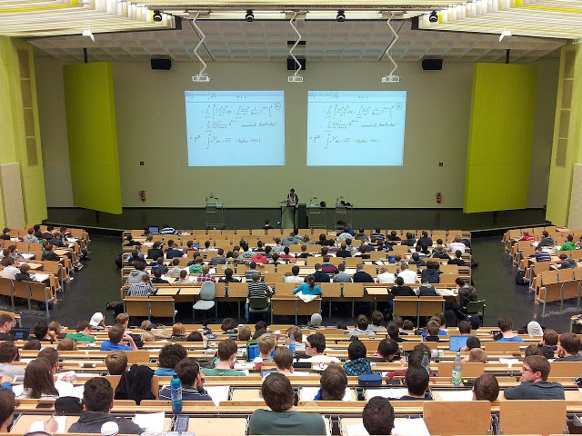
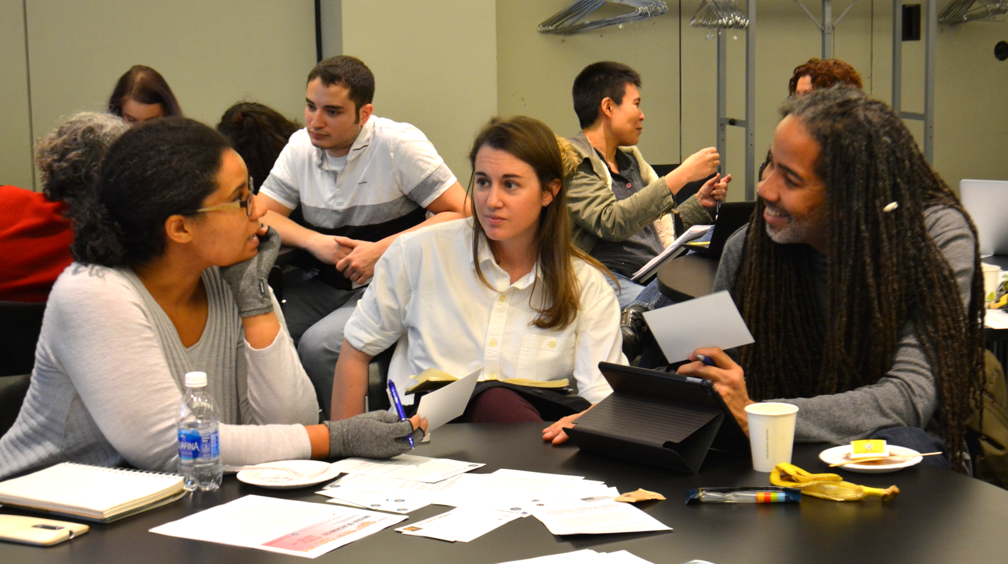
#7. Engage in Serious Faculty Training in Effective, Equitable, Active Pedagogy, Leadership, and Mentoring
Nikolayhg on Pixabay
Futures Initiative
(Cf. 2014 PNAS “metastudy” of 240 studies: https://www.pnas.org/doi/10.1073/pnas.1319030111)
Notes:
Everything about the legacy we have inherited---and that is institutionalized in our ranking and accreditation systems--is about the person at the front of the room: THE TEACHER. And that teacher’s teachers. And that teacher’s teachers. Replication. What happens when we disrupt the entire premise? What happens when we disrupt the model? Stanford Physics Nobel Prize Winner and Prof of Education Carl Wieman notes that we have 40 years of studies and over 1000 studies on superiority of active versus either lecture or “distributed lecture” methods that humanists call “discussion.” A PNAS meta-study of 250 separate studies was so conclusive that the authors noted, if it were a pharmaceutical study, traditional learning would be taken off the market.Scott Freeman srf991@u.washington.edu, Sarah L. Eddy, Miles McDonough, +3 , and Mary Pat WenderothAuthors Info & Affiliations
Edited* by Bruce Alberts, University of California, San Francisco, CA, and approved April 15, 2014 (received for review October 8, 2013)
May 12, 2014
111 (23) 8410-8415
https://doi.org/10.1073/pnas.1319030111
Louis Deslauriers, Logan S. McCarty, Kelly Miller,
Kristina Callaghan, and Greg Kestin
PNAS
September 24, 2019 116 (39) 19251-19257; first published September 4, 2019; https://doi.org/10.1073/pnas.1821936116; Peter
Reuell, “Study shows that students learn more when taking part in classrooms
that employ active learning strategies,” The Harvard Gazette,
September 4, 2019,
https://news.harvard.edu/gazette/story/2019/09/study-shows-that-students-learn-more-when-taking-part-in-classrooms-that-employ-active-learning-strategies/.

Slide 31
Cathy N. Davidson and Shelly Eversley, “Practicing the Equitable, Transformative Pedagogy We Preach,” Inside Higher Ed, 2021.
Scott Freeman, et. al., “Active learning increases student performance in science, engineering, and mathematics,” Proceedings of the National Academy of Sciences (PNAS), vol. 111, no. 23, 2014, pp. 8410-8415.
Louis Deslauriers, et. al., “Measuring actual learning versus feeling of learning in response to being actively engaged in the classroom,” PNAS, vol. 116, no. 39, 2019, pp. 19251-19257.
Beth McMurtrie, “Why the Science of Teaching is Often Ignored,” Chronicle of Higher Education, January 2022.
Theobald, E. J., et al., “Active learning narrows achievement gaps for underrepresented students in undergraduate science, technology, engineering, and math,” PNAS, vol. 117, no. 12, 2014, pp. 6476-6483.
Carl Wieman, Improving How Universities Teach Science (Harvard UP, 2017).

Slide 32
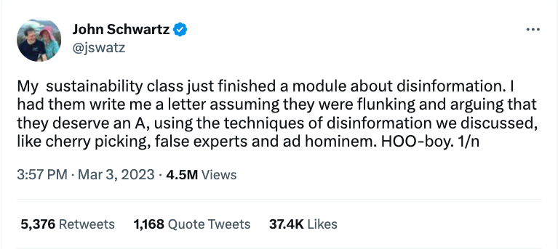

Slide 33
Notes:
Academic Success

Slide 34
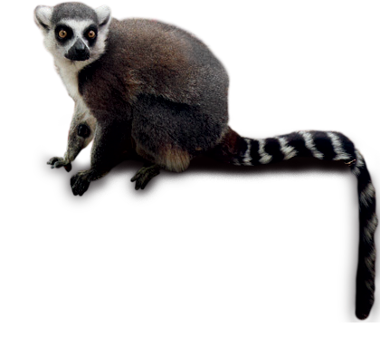
Exit Ticket
What questions do you have for me?
Notes:
INTERACTIVE Mentimeter---questions And then I’ll read from the questions!

Slide 35
Special thanks to Jackie Cahill (Program Coordinator for the Futures Initiative and the Senior Advisor) for her help with this slide presentation. I also thank Christina Katopodis (coauthor of The New College Classroom) for her insights and inspiration—and to all of you for caring enough about learning to be here today. Also special thanks to Maha Bali for her generous assistance on the Mentimeter today!
Thank You
Cathy N. Davidson
Senior Advisor to the Chancellor on Transformation
@CathyNDavidson
Distinguished Professor and Founding Director
The Futures Initiative
The Graduate Center, CUNY

