Slide 1


Academic Success and Student Transformation
K16 Innovation Summit
Tuesday, June 20, 2023
10:00-10:20
Cathy N. Davidson
Senior Advisor to the Chancellor on Transformation
Founding Director, Futures Initiative, GC CUNY
Distinguished Professor of English, Digital Humanities,
and Data Analysis and Visualization

Slide 2
Office of Transformation
Rachel Stephenson, Chief Transformation Officer; Cathy N. Davidson, Senior Advisor to the Chancellor on Transformation;
Woldine Guerrier, Lead Administrator; Jacqueline Cahill, Administrative Assistant; Roberta Garbarini-Philippe, Special Projects
Notes:
POWERPOINT LAYOUT: TITLE SLIDE
Solid CUNY Blue Background or CUNY Blue Duotone

Slide 3
Office of Transformation
Our Mission
“Our mission is broad, responsive, and ever changing. We hope to convene and also to listen, to share best practices so others can learn from inspiring models of successful and equitable change, to solve problems and also to wrestle collectively with seemingly intractable ones. We strive to be a hopeful beacon for CUNY and all of higher education, showing that change is necessary and transformation possible.”
Notes:
POWERPOINT LAYOUT: TITLE AND CONTENT

Slide 4
Office of Transformation
History and Initiatives
Established in June 2022
Goal is to amplify CUNY’s position as the nation’s premier university for equitable social, economic, and civic impact
Core values include “academic success” (ensuring that student success is also faculty success), listening, and community engagement
Notes:
POWERPOINT LAYOUT: TITLE AND CONTENT

Slide 5
Major Strategic Focus: Our Students’ Futures
Spearheading Associates in Applied Science (AAS) Redesign Initiative (focusing on 25 different degree programs across CUNY)
Coordinating the Black, Race, and Ethnic Studies Initiative (BRESI), including funding 126 projects focused on curriculum, climate, student internships, research.
Distributed $750,000 in Campus Climate Support Grants
Leading Careers Across the Disciplines, including funding 50 new Faculty Fellows, two from each campus, one in liberal arts and one in STEM or Business fields
Notes:
POWERPOINT LAYOUT: TITLE AND CONTENT

Slide 6
Listening Sessions
4 Listening Sessions in Fall 2022
Listening Session 1: Career Services Advisors and Other Career-Engaged Administrators
Listening Session 2: Students
Listening Session 3: Faculty
Listening Session 4: Employers
Notes:
POWERPOINT LAYOUT: TITLE AND CONTENT

Slide 7
Faculty Survey
Faculty survey
Over 1,600 FT & PT faculty teaching all degree levels at all CUNY colleges responded
94% of faculty respondents consider it their responsibility to prepare students for their professional aspirations
87% of respondents are interested in including career preparation information in their classes
70% of respondents think faculty are not trained and 78% of respondents think faculty are not incentivized to integrate career-relevant information into the curriculum
Notes:
POWERPOINT LAYOUT: TITLE AND CONTENT

Slide 8
Focus: Five High-Impact Areas
Five high-impact areas
Syllabus and curriculum revision
Work-based learning: internships, apprenticeships, community partnerships
Student support
Employer engagement: internships, apprenticeships, partnerships
Continuous improvement & utilization of data
Link: https://docs.google.com/spreadsheets/d/1opaMJTTYkmGW1OVKGyXNbVjViqp7oAg1w9L_PaG80RQ/edit#gid=893210433
Notes:
POWERPOINT LAYOUT: TITLE AND CONTENT

Slide 9
Faculty Professional Development and Peer-to-Peer Collaboration
Notes:
POWERPOINT LAYOUT: TITLE SLIDE
Solid CUNY Blue Background or CUNY Blue Duotone

Slide 10
Educating Higher: Why Stay in School?
The #1 reason students fail to complete college is financial (a survey conducted by former Georgia State President Mark Becker found that students are six times more likely to drop out for financial than educational reasons).
The #2 reason students fail to complete college is they don’t know why they’re in college—and aren’t sure how their classroom learning connects to their future.

Slide 11
Educating Higher: Equity & Efficacy
Only 3.5% of college graduates (nationally) go on to earn a PhD. How do we teach and prepare the other 96.5%?
Experiments on forgetting (going back to the 1880s) show that we forget about 75% of specific content soon after an exam unless we apply it. But… we often absorb and retain “life lessons” from our personal experiences (applied learning) and from inspiring, caring teachers for our entire lives.
“Metacognition” helps our students understand “why” they learn what they learn and how it applies to their lives and future careers—not just “career skills” but “life preparedness.”

Slide 12
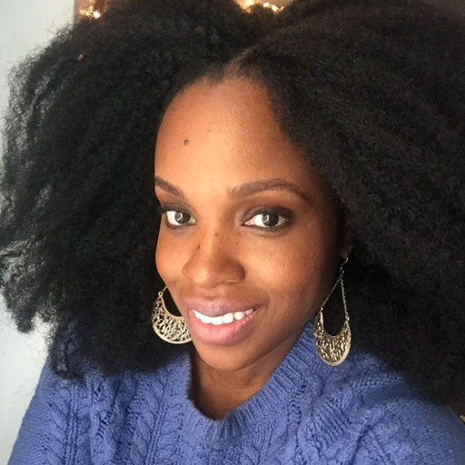
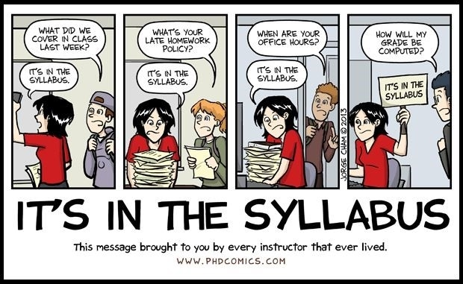
Syllabus: Goals Beyond the Classroom
Use pedagogies of care: add our widest goals, mission statement (too often our syllabi read like a “terms of service” agreement)
Include url for student services, health and mental health care, financial aid, visa, and career services. Make the link to Career Services part of our care for our students
Connect course content to crucial life and career skills and values
https://www.hastac.org/blogs/adashima-oyo/2020/01/29/last-page
Adashima Oyo, Executive Director of the Futures Initiative, “The Last Page,” HASTAC.org

Slide 13

8 Career Competencies Employers Value Most
National Association of Colleges and Employers (NACE)
1. Career and Self-Development
2. Communication Skills
3. Critical Thinking/Problem Solving
4. Equity, Inclusion, Anti-Racism, Cross-cultural Skills
5. Leadership
6. Professionalism
7. Teamwork
8. Technology basics
(Psssst . . . we’ve got this!)
Resources: NACE
Notes:
POWERPOINT LAYOUT: TWO CONTENT
Image size 5.5” wide x 3” tall @ 96 ppi [528x288 pixels]

Slide 14
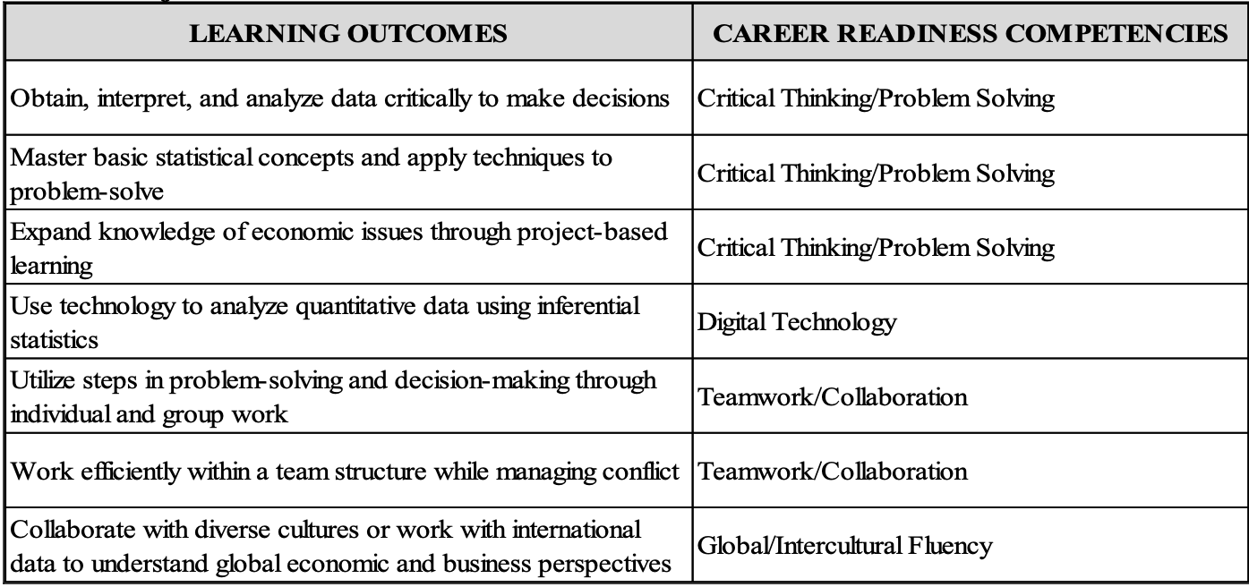
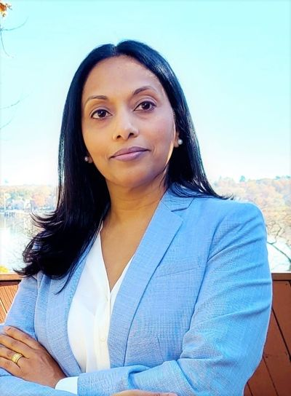
Schiro Withanachchi, Career Success Fellow
Queens College (Econ 249, Applied Statistics & NACE Career Competencies)
Notes:
POWERPOINT LAYOUT: TWO CONTENT
Image size 5.5” wide x 3” tall @ 96 ppi [528x288 pixels]

Slide 15
Knowledge Is Power …
Consider including a chart like this in your syllabus. Or take 10 minutes of the tedious and rarely effective “let’s go over the syllabus” time and have students work in groups, review the syllabus, and connect the “basics” of the course to the career/“world readiness” competencies. Have them think big picture—“meta” and “mission.”
Course Requirements or Learning Outcomes | Career Readiness Competencies
Notes:
POWERPOINT LAYOUT: TWO CONTENT
Image size 5.5” wide x 3” tall @ 96 ppi [528x288 pixels]

Slide 16
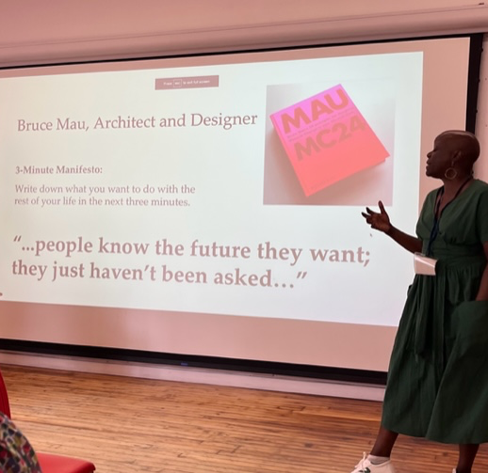

“Community is a Learning Outcome”
Professor Shelly Eversley, Interim Director Black and Latinx Studies, Baruch College, co-director Transformative Learning in the Humanities (Mellon), and incoming Faculty Co-Chair, The Futures Initiative, Graduate Center CUNY.
Notes:
POWERPOINT LAYOUT: CONTENT WITH IMAGE RIGHT
Image format SQUARE. Size 7.5” wide x 7.5” tall @ 96 ppi [720x720 pixels]
Headline with secondary text — Plus Full Image to Right

Slide 17

Headlines
What Do You Want as the
‘Learning Outcome’ of Your Education?
“I want to make my mother proud.”
“I want to serve my community.”
Notes:
POWERPOINT LAYOUT: BLANK
Image Size 13.35” wide x 7.5” tall
Quotes on Duotone, SOLID CUNY Blue Background could be substituted

Slide 18
Headlines
“The Everyday Work of Transformation”
Cathy N. Davidson and Rachel Stephenson
Inside Higher Ed
June 20, 2023
https://www.insidehighered.com/opinion/views/2023/06/20/everyday-work-office-transformation-opinion
Notes:
POWERPOINT LAYOUT: BLANK
Image Size 13.35” wide x 7.5” tall
Quotes on Duotone, SOLID CUNY Blue Background could be substituted

Slide 19

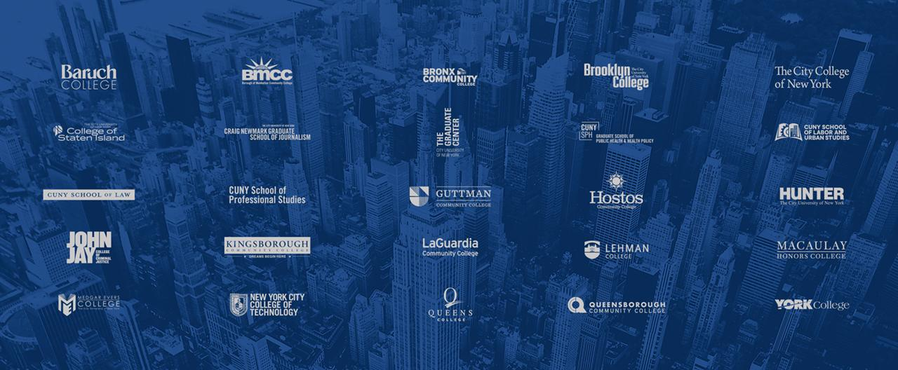
Thank you!
Notes:
POWERPOINT LAYOUT: TITLE ONLY
Image with 25 colleges [13.33” wide x 5.5” tall]

